Slide 1

Real Estate Website Management
SE1414-Group 3
Lecturer: Phạm Ngọc Hà

Slide 2
ABOUT US
HE140233 Hà Văn Quang
HE140271 Nguyễn Thành Long
HE140298 Nguyễn Trọng Duy An
HE140305 Hoàng Đức Trường
HE140309 Hà Phẩm Cương

Slide 3

Project Overview

Slide 4

Product background
-2021 is a great year for estate market.
-This project can help estate businesses to reach customer anytime, anywhere.
-You can have real estate transaction easily..

Slide 5

Existing System
-Mobile Application
-Website Application

Slide 6
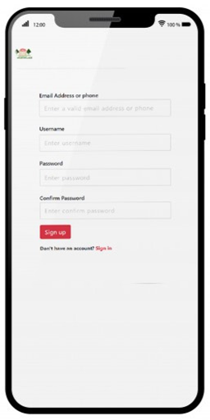
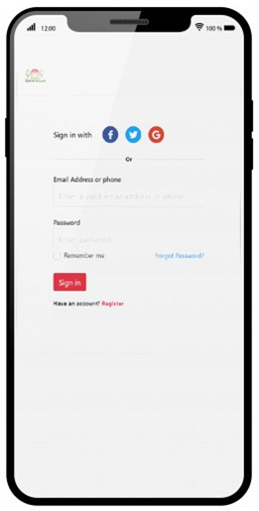
Mobile application-1
- Can be downloaded on Google Play and Apps Store.
-On seller side: Upload their apartment right on apps.
-On buyer side: Search, view information of
the apartment they want to buy.

Slide 7
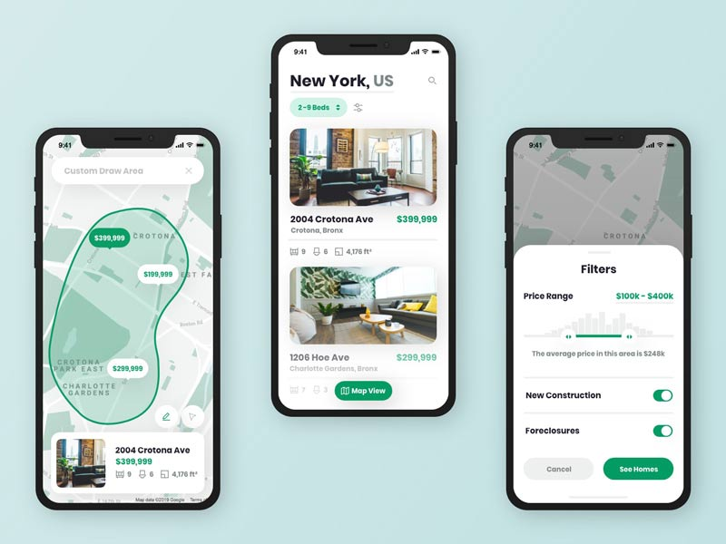
Mobile application-2
+Advantage:
-GUI friendly, support Vietnamese language.
-Public on Google Play and App Store.
-Easy to use.
+Disadvantage:
-Only support Vietnamese.
-Need Internet to take notification.

Slide 8

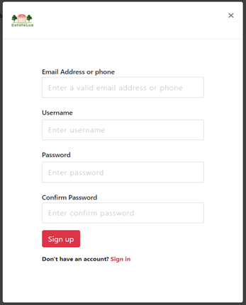
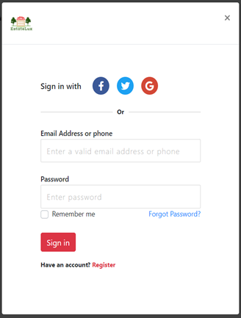
Web application-1
-Published publicly on the Internet.
-Help real estate company to promote its businesses.
-Users can find a house easily.
-The server use MySQL for security and simple configuration.

Slide 9
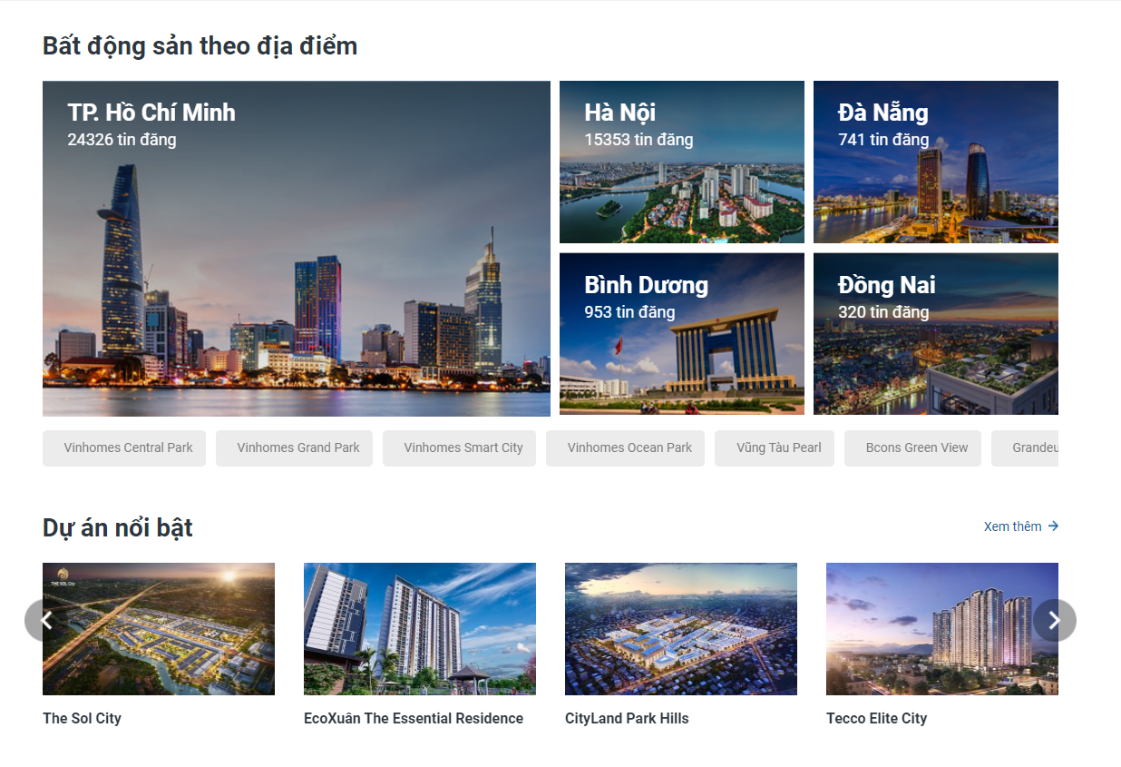
Web application-2
-Backend system is made based on Spring MVC.
-Frontend using MVC, HTML, CSS and JavaScript.

Slide 10
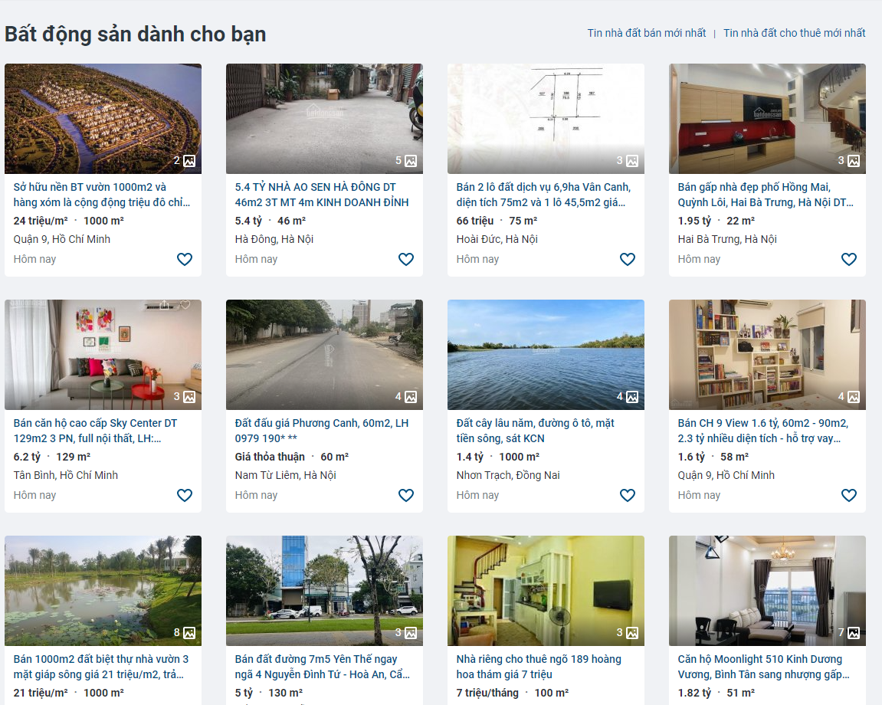
Web application-3
+Advantage:
-GUI friendly, support Vietnamese language.
-Website staff will on the website 24/7.
-App can be accessed anytime as long as the Internet connected.
+Disadvantage:
-Only support remote access and via hotline,facebook.
-Low security.

Slide 11
Business Opportunity

Slide 12

- The easy-to-use interface can be suitable for many types of customers .
- Online working system., so staff always online 24/7.
- The system will always update information on real estate projects quickly and accurately. Smartphone application development.

Slide 13
Software Product Vision

Slide 14

-Targets are real estate sellers and buyers.
-Summarize detail of every available real estate projects and information of the sellers.
-Buyers can contact directly to the sellers.

Slide 15
Project Scope and Vision

Slide 16



-Projects, supporting real estate in the Vietnamese market
Real estate is concentrated in big cities
This is a newly started project so there is many mistake.

Slide 17


